Slide 1
Regen
Yi-Hao Chen
11/25/2024

Slide 2
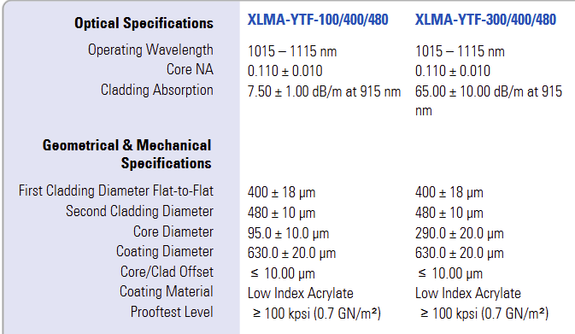
Conditions
Input pulse
300 fs; stretched to 200 ps
0.1 nJ
Fiber (Coherent's XLMA-YTF-100/400/480)
30-cm long
14-W (co-)pump at 976 nm
Regen
60-MHz cavity
10-kHz operation rate
6 passes (assume a ring cavity)

Slide 3
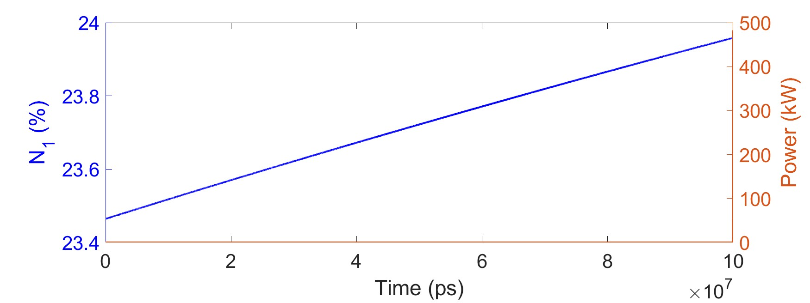
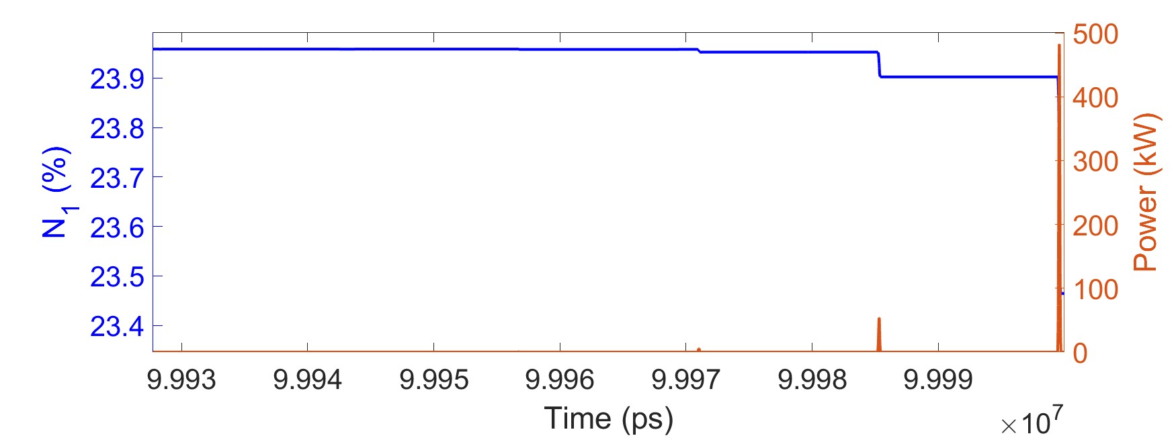
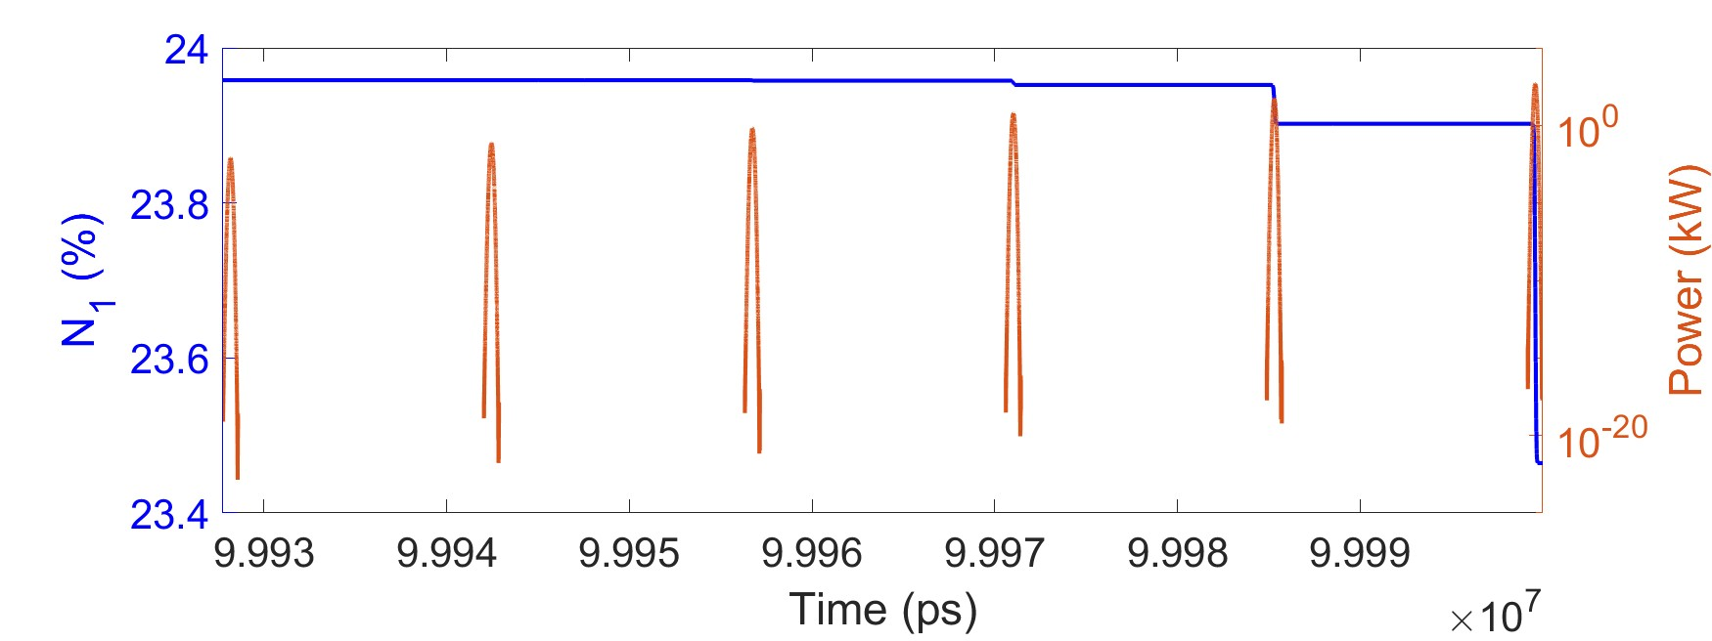
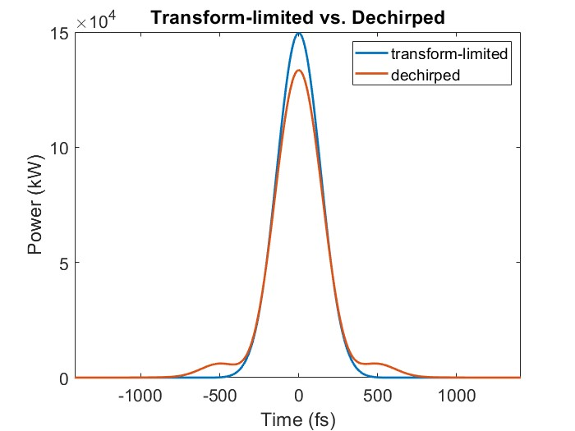
Results
Output pulse
52 µJ
343 fs after dechirped
0.9 Strehl ratio
Just log scale for fields
Energy (each pulse; first to last): 0.9 nJ, 8 nJ, 72 nJ, 650 nJ, 5800 nJ, 52000 nJ

Slide 4
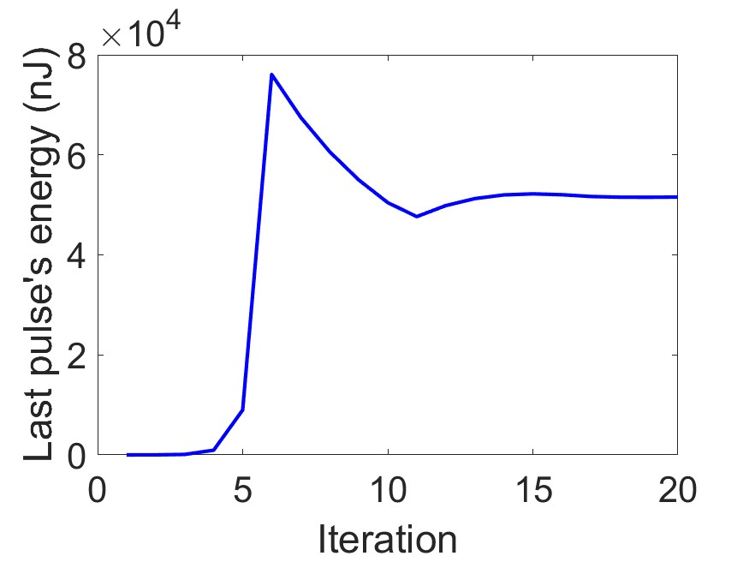
Simulation convergence
Time window includes a sequence of 6 pulses
Simulation of regen
Initially 6 equal seeds
After each pass of gain fiber, replace the second pulse with the first pulse, the third pulse with the second pulse, etc. Then replace the first pulse with the original seed.
Iterate until simulation converges.
Simulation time
1 min per pass = 20 min in total for each simulation in this test
I can make this around 10x faster I think, but I need to rewrite a few functions (potentially a few days of work). This is important for regen with many passes.
Still don’t know how to simulate a linear cavity due to two propagating directions.

Slide 5
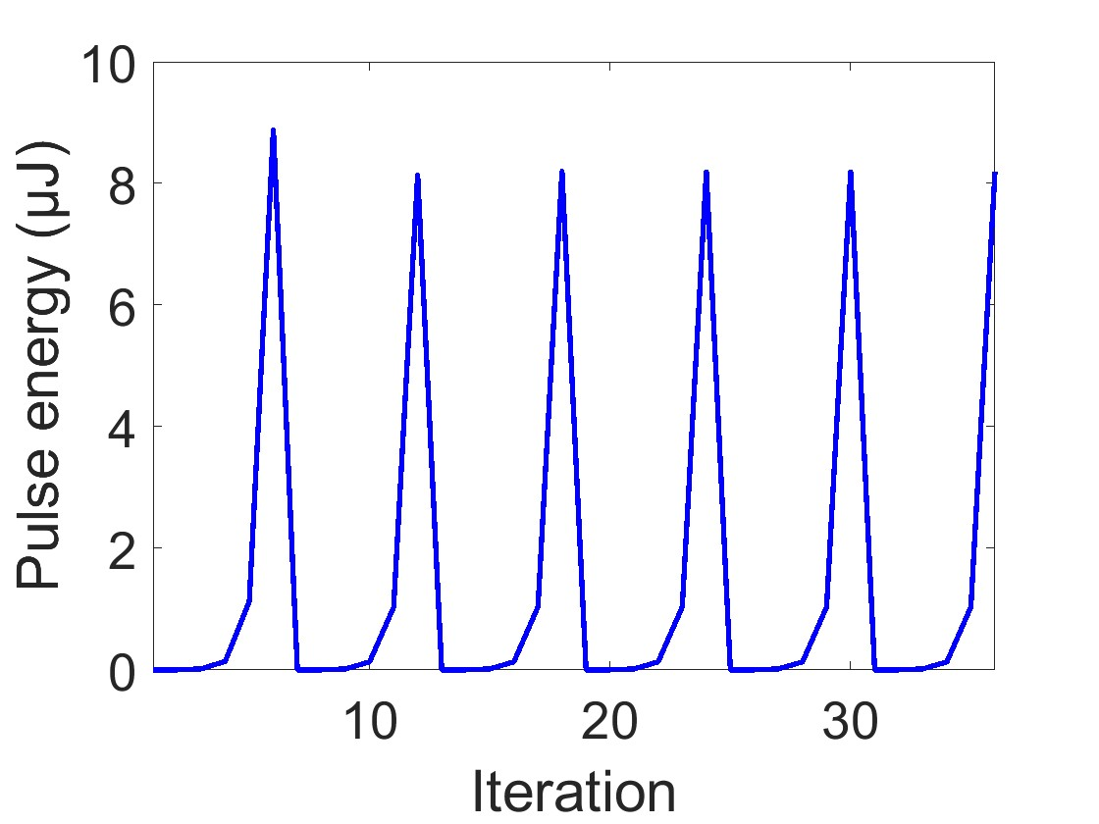
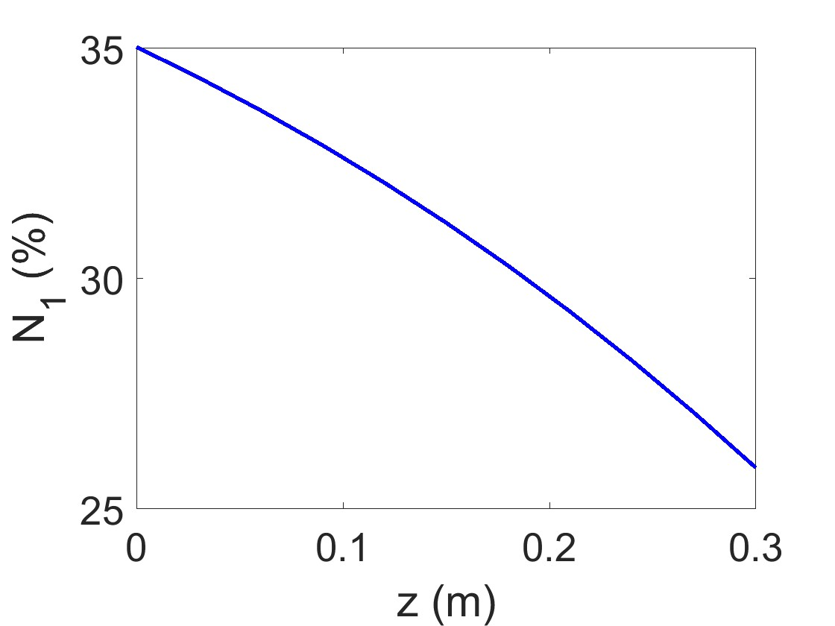
Another simulation: Run with “Steady-state assumption”
Steady-state assumption
Each i^{th} pass amplification is saturated by fields in other 5 passes, through pulse energy
Lower output energy (8.2 µJ) than the realistic transient simulation
10 kHz is too low for the steady-state formula to be correct.
Converge
Energy (each pulse; first to last): 0.4 nJ, 2.5 nJ, 18 nJ, 134 nJ, 1000 nJ, 8200 nJ

Slide 6
Steady-state vs. transient simulations
Lower N₁ and higher pulse energy in the transient regime → stronger energy extraction
I don’t know how to conclude why steady-state pulse energy is weaker
Higher N₁ should mean higher gain → stronger pulse
But, higher N₁ means weaker energy extraction → weaker pulse
Perhaps these two effects compete, making it difficult to say why steady state produces a weaker pulse here. Steady-state assumption for 10 kHz isn’t realistic anyway.

